Slide 1
Watlab installation
Yuan-Hung Chiu
2025/11/23

Slide 2
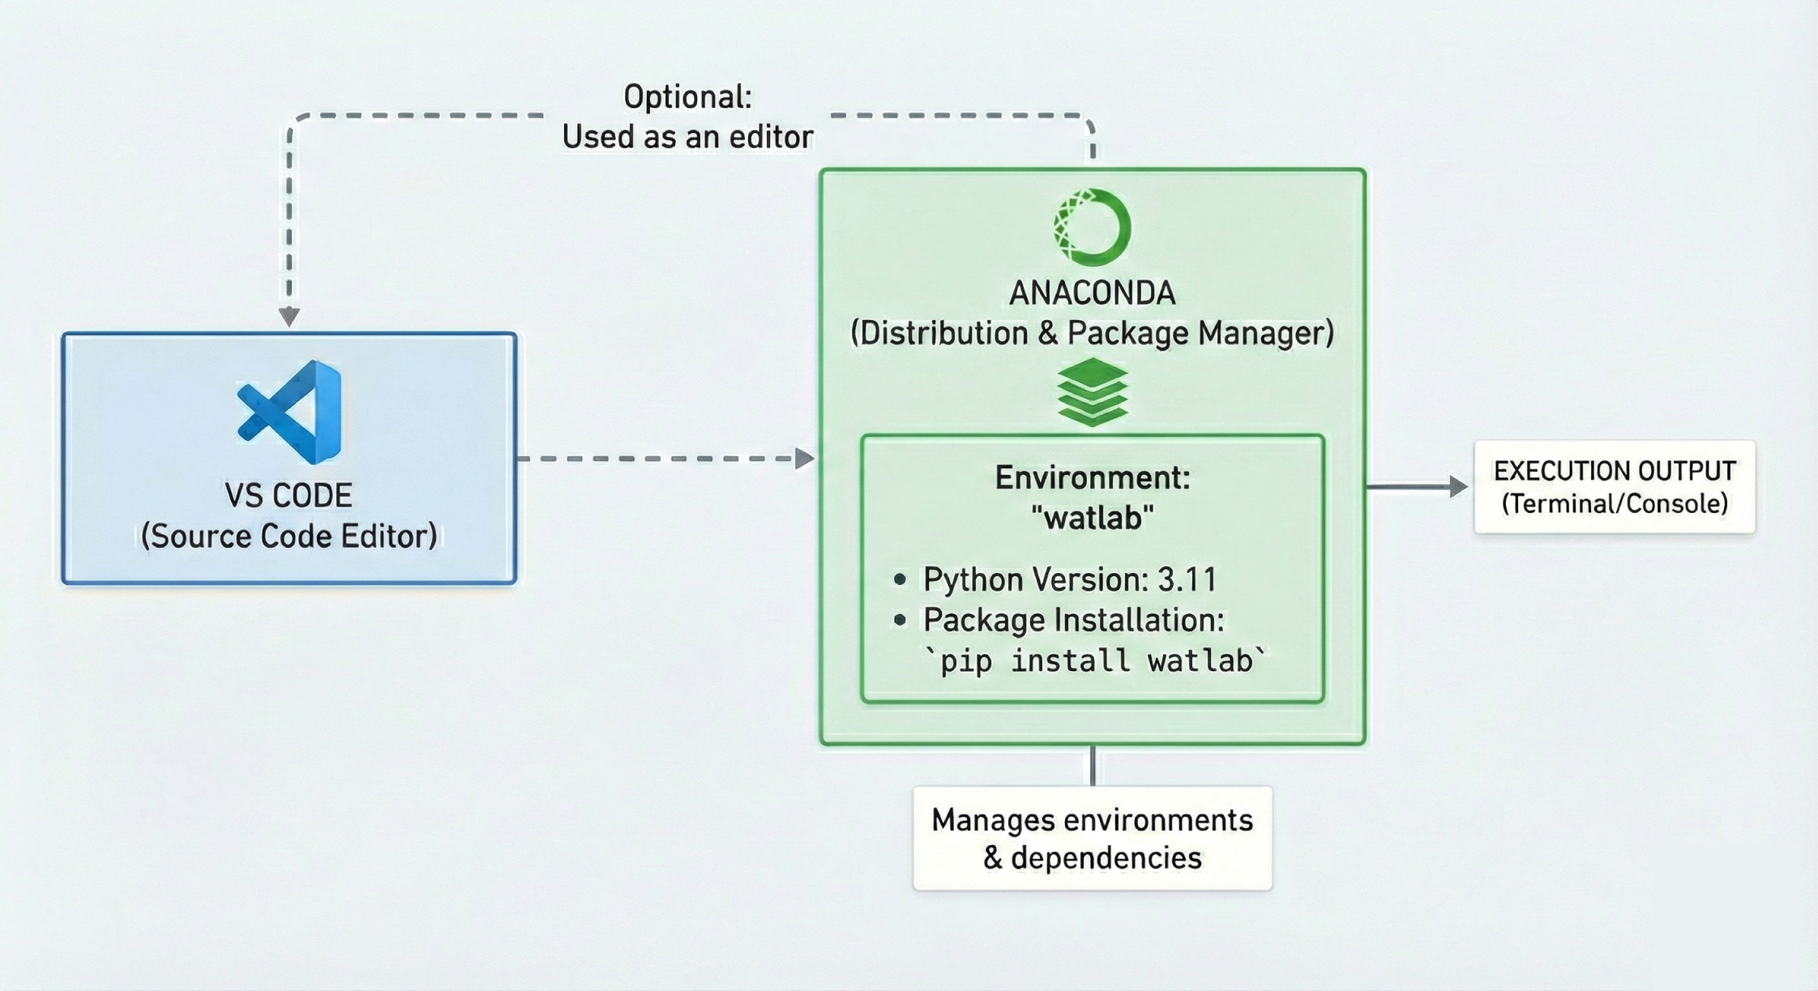


Slide 3
Contents
Install Anaconda
Install Visual Studio Code
Watlab environment setup
Run the first watlab code

Slide 4
Contents
Install Anaconda
Install Visual Studio Code
Watlab environment setup
Run the first watlab code

Slide 5
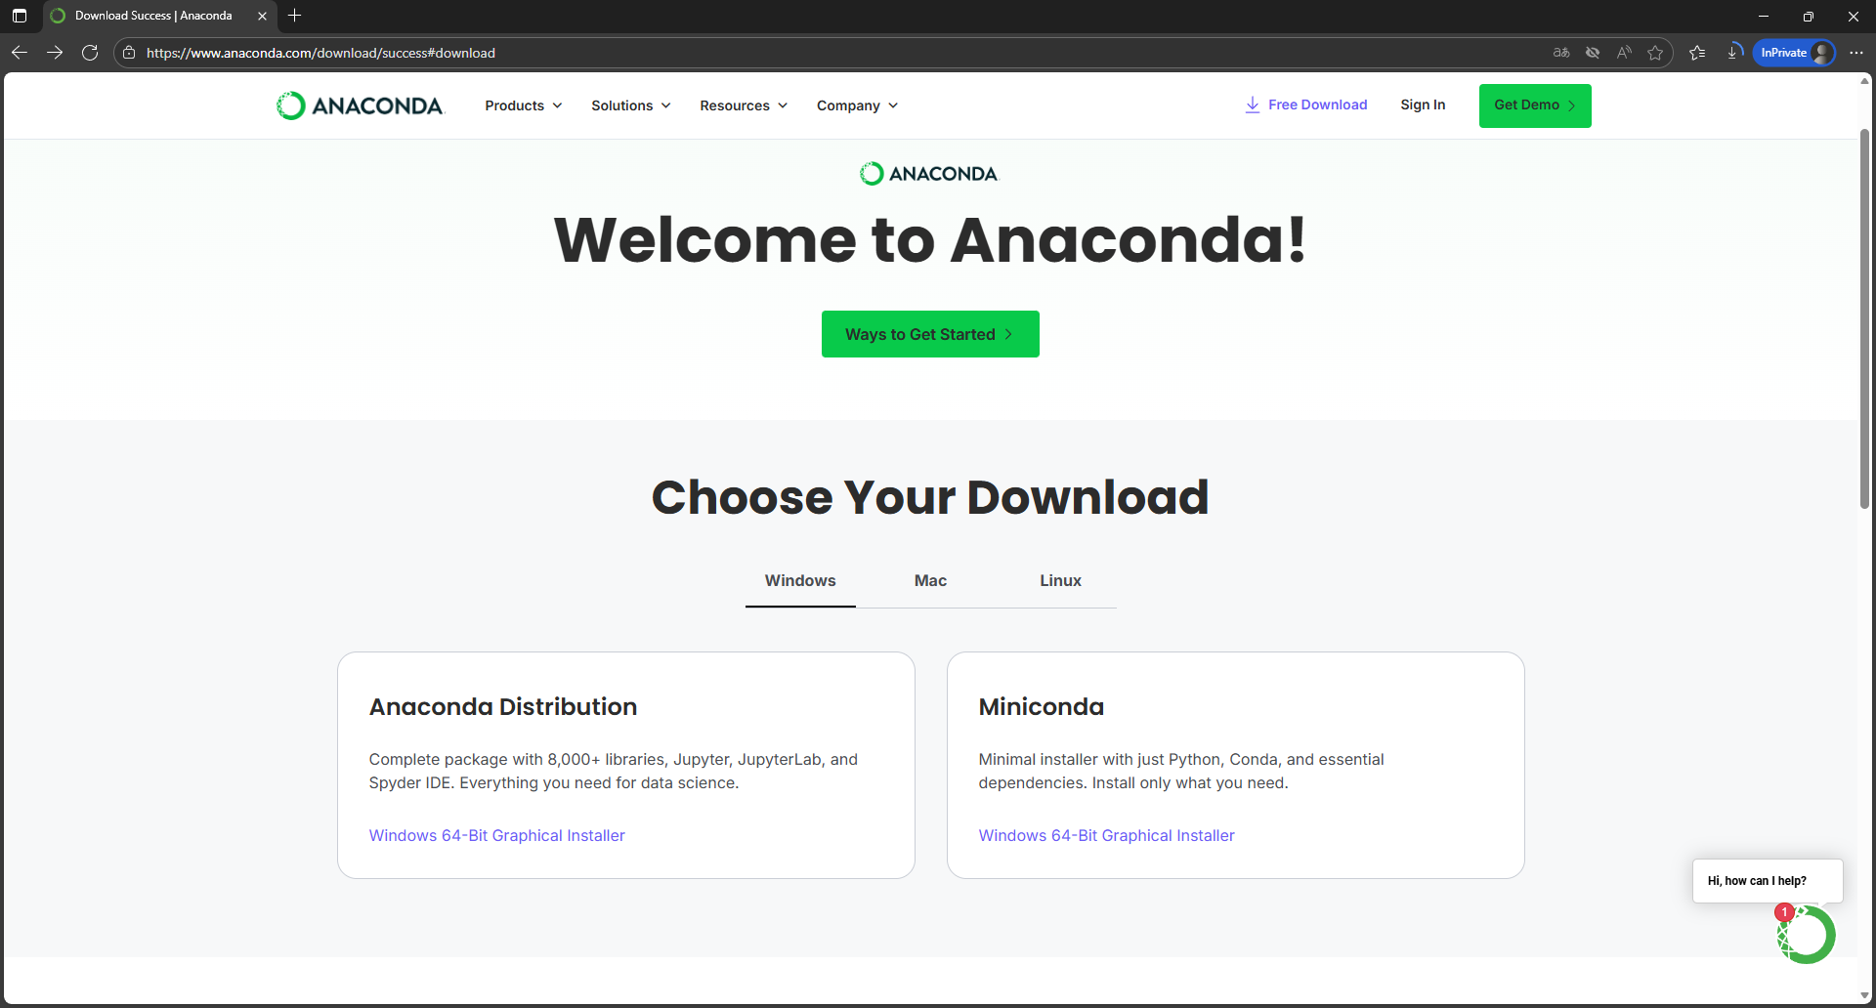
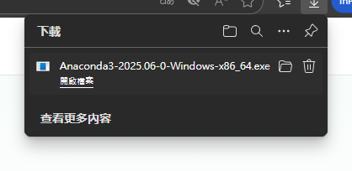
3.
1.
Download link: https://www.anaconda.com/download/success#download
2.

Slide 6
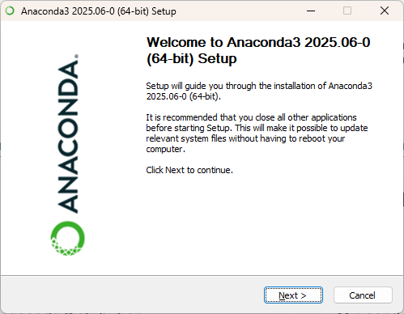
Anaconda installation (keep as default)

Slide 7
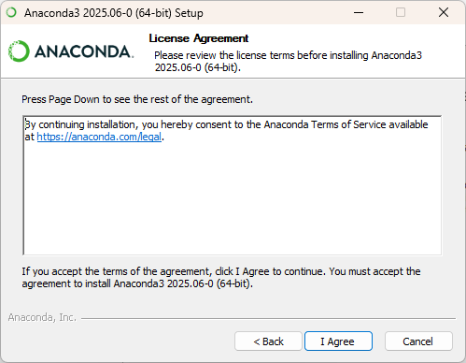
Anaconda installation (keep as default)

Slide 8
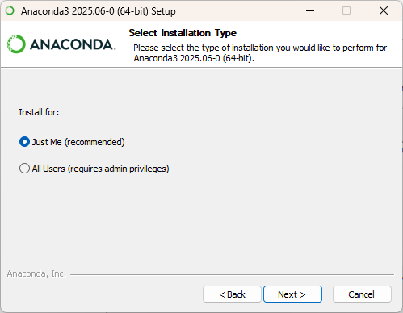
Anaconda installation (keep as default)

Slide 9
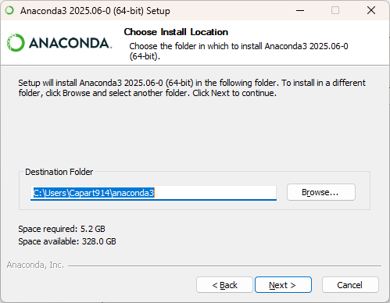
Anaconda installation (keep as default)

Slide 10
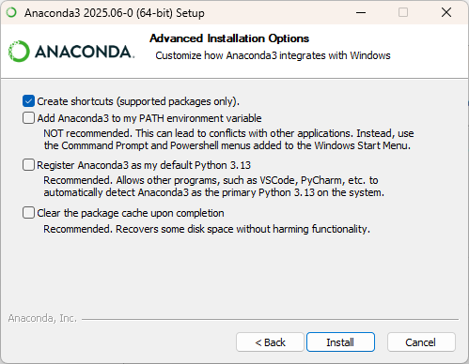
Anaconda installation (keep as default)

Slide 11
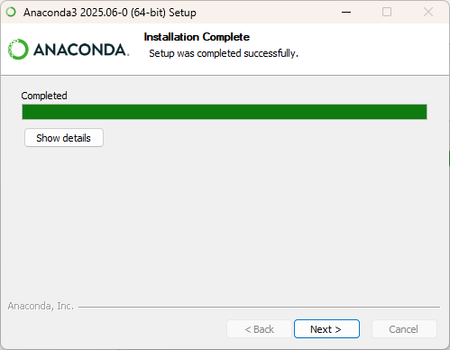
Anaconda installation (keep as default)

Slide 12
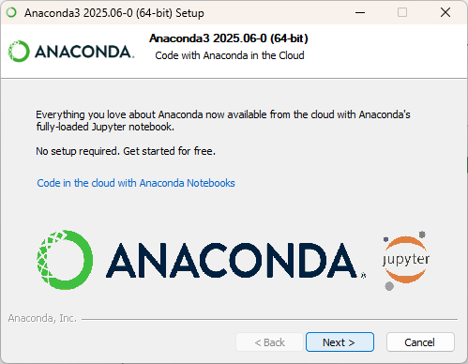
Anaconda installation (keep as default)

Slide 13
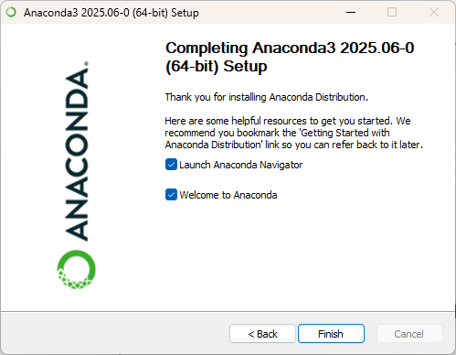
Anaconda installation (keep as default)

Slide 14
Contents
Install Anaconda
Install Visual Studio Code
Watlab environment setup
Run the first watlab code

Slide 15
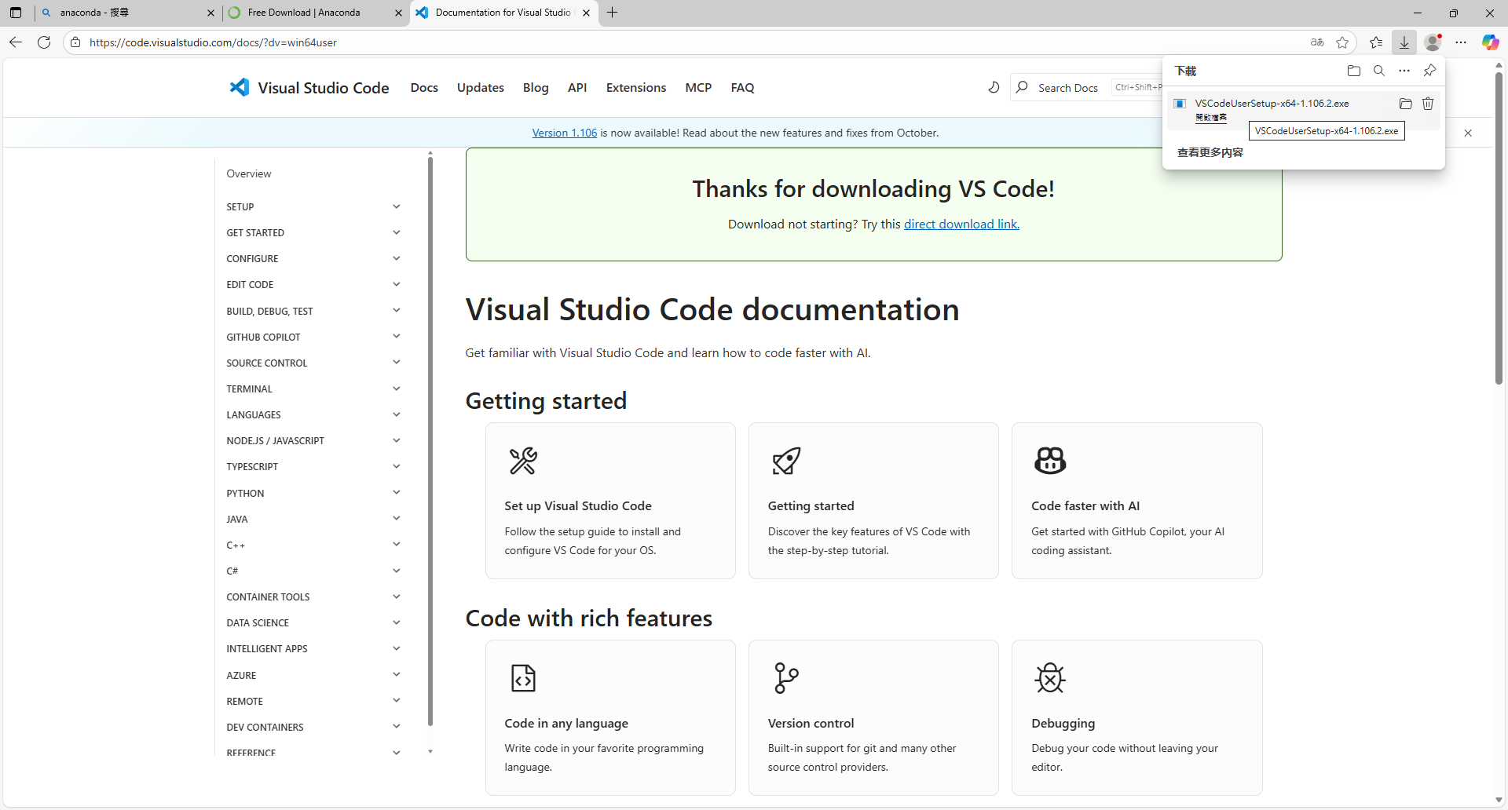

Slide 16
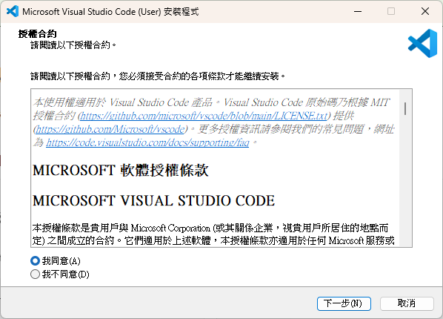
VS code installation (keep as default)

Slide 17
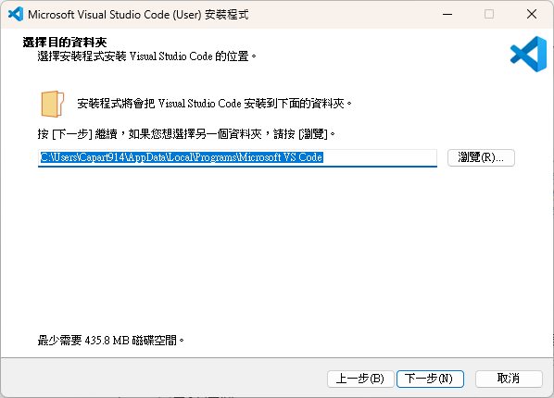
VS code installation (keep as default)

Slide 18
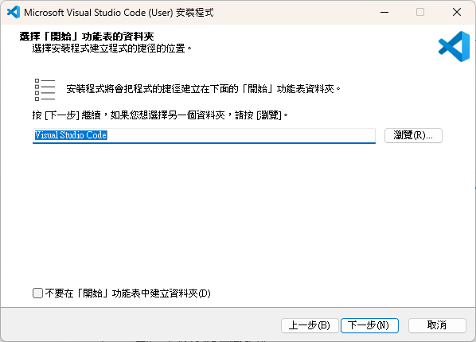
VS code installation (keep as default)

Slide 19
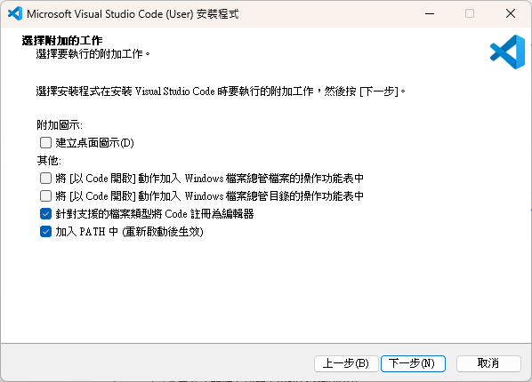
VS code installation (keep as default)

Slide 20
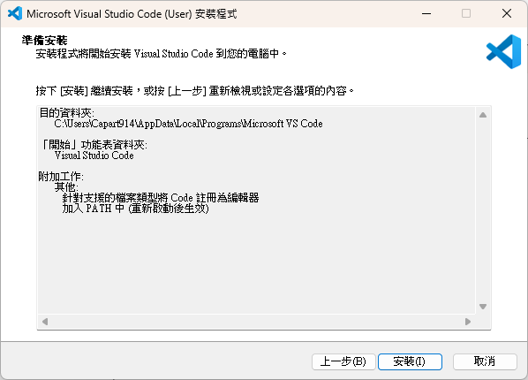
VS code installation (keep as default)

Slide 21
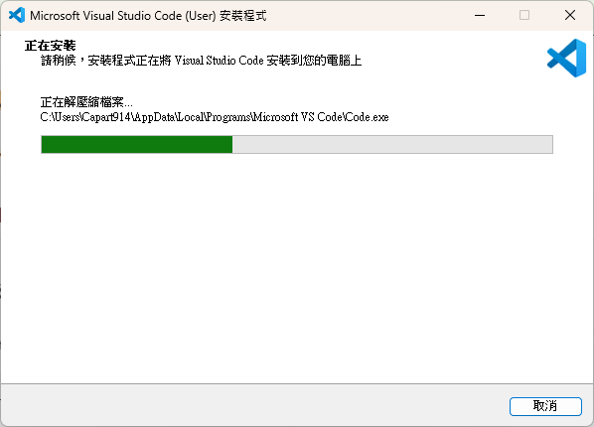
VS code installation (keep as default)

Slide 22
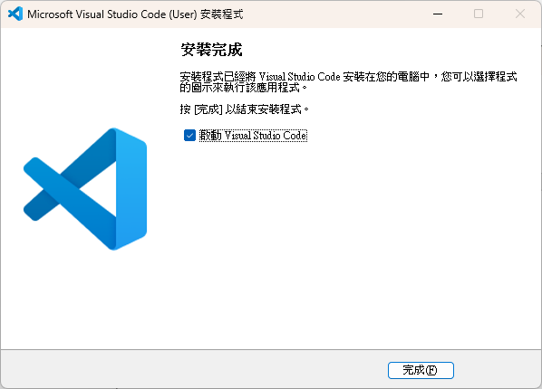
VS code installation (keep as default)

Slide 23
Contents
Install Anaconda
Install Visual Studio Code
Watlab environment setup
Run the first watlab code

Slide 24
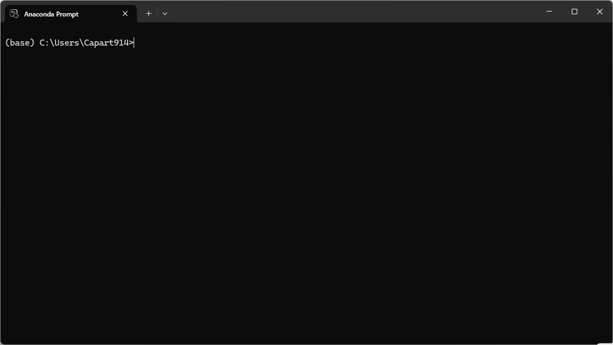
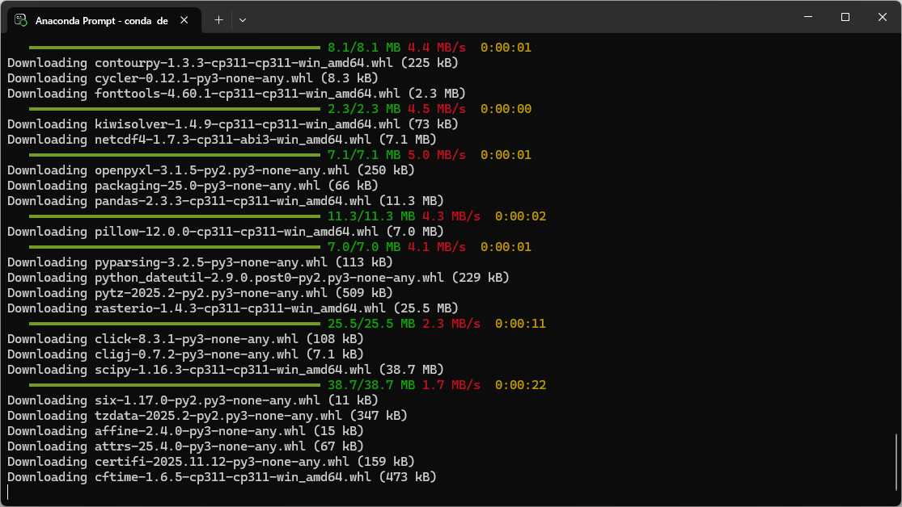
Create a Watlab environment in Anaconda
1. Open Anaconda Prompt
2. Type the following commands one by one.
Press [y] whenever it asks you to confirm the
installation.
conda create --name watlab python=3.11
conda activate watlab
python -m pip install watlab
Please wait until it finish…..

Slide 25
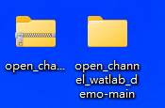
Install GDAL
1. The link for Watlab installation instruction and today’s demo scripts:
https://github.com/damiel-hub/open_channel_watlab_demo
2. Please un-zip the folder first.
3. Navigate to the directory “open_channel_watlab_demo-main\environment_setup” using the cd command in
Anaconda Prompt.
Note: If the folder is on a different drive (e.g., D:), switch to that drive first by typing the drive letter followed by a
colon (:).
4. Type the following commands in the Anaconda Prompt.
cd to_your_path\open_channel_watlab_demo-main\environment_setup
python -m pip install GDAL-3.4.3-cp311-cp311-win_amd64.whl

Slide 26
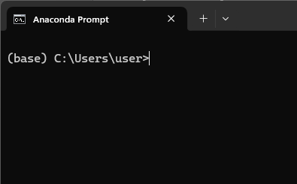
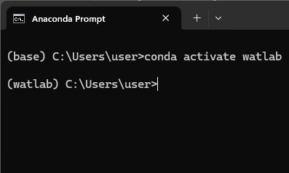
Install seamsh
This step should be done after the installation of GDAL
Open the Anaconda Prompt and type the following command to install seamsh:
Type this first if you are not in the watlab environment
conda activate watlab
python -m pip install seamsh
Type this command to install seamsh module
Not in the watlab environment.
In the watlab environment.

Slide 27
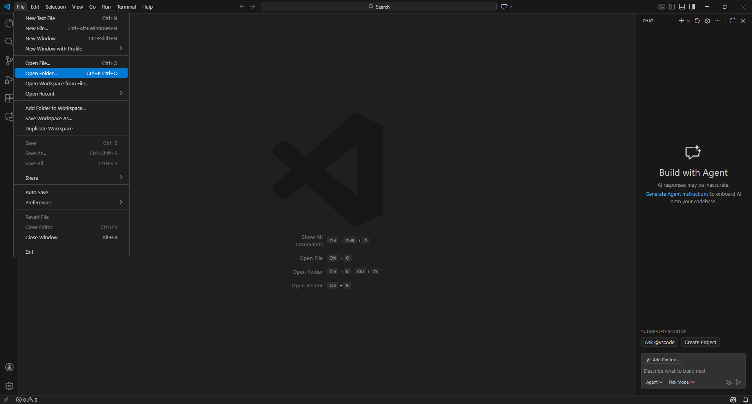
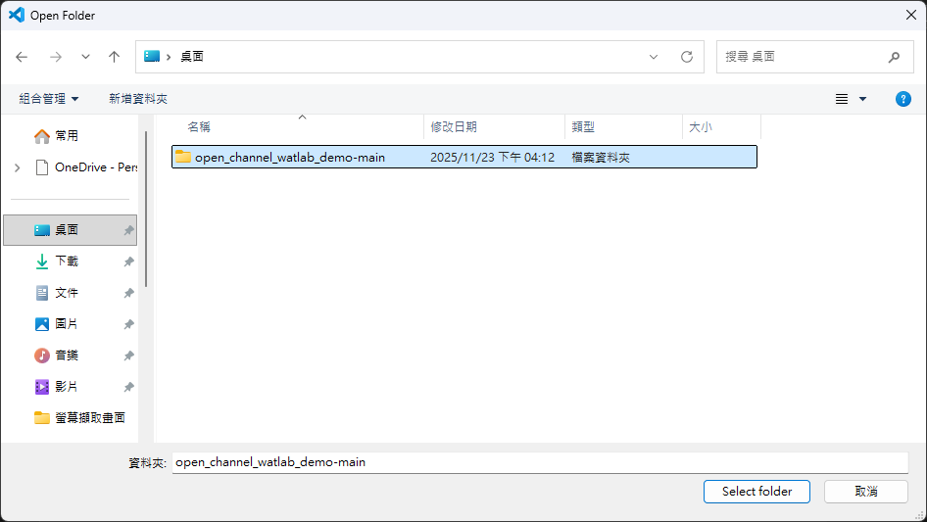
1.
2.
3.
4.
Open the demo folder in VS code (1/2)

Slide 28
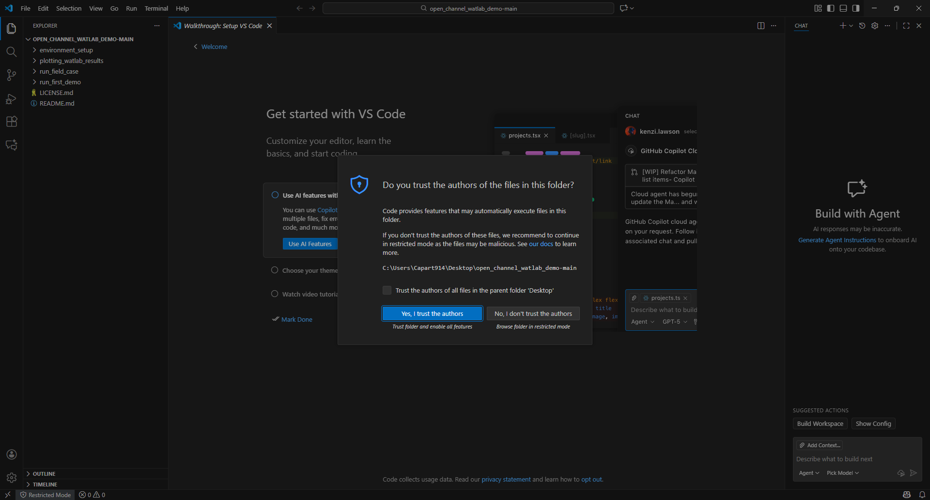
Open the demo folder in VS code (2/2)

Slide 29
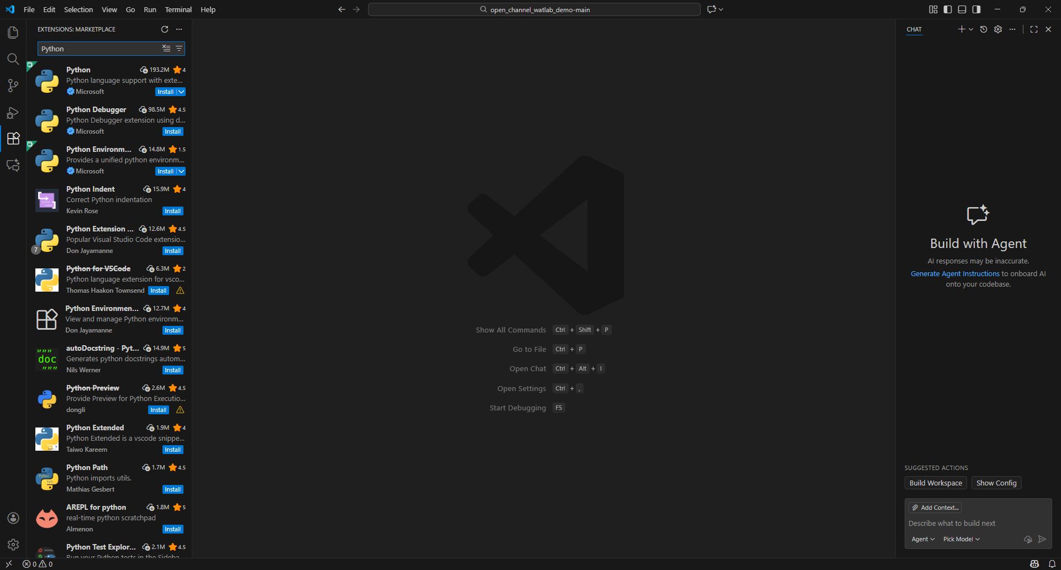
2. Search Python
3. Click install
1.
Connent Python in Watlab env to VS code (1/2)

Slide 30
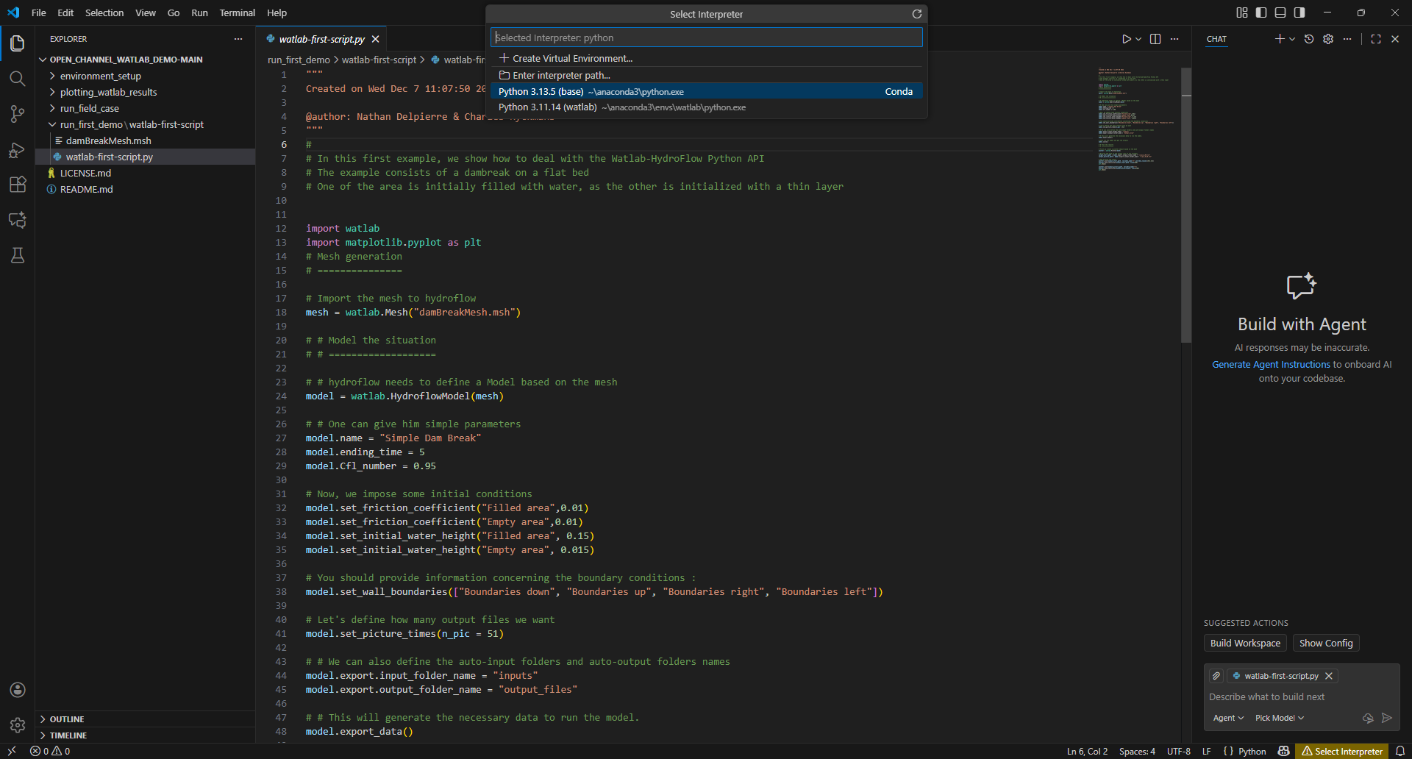
2. Select the python in the watlab environment
If you can not find “Select Interpreter” button, please press “ctrl+shift+P” and type the command “Python: Select Interpreter” to select the environment.
Connent Python in Watlab env to VS code (2/2)
1.

Slide 31
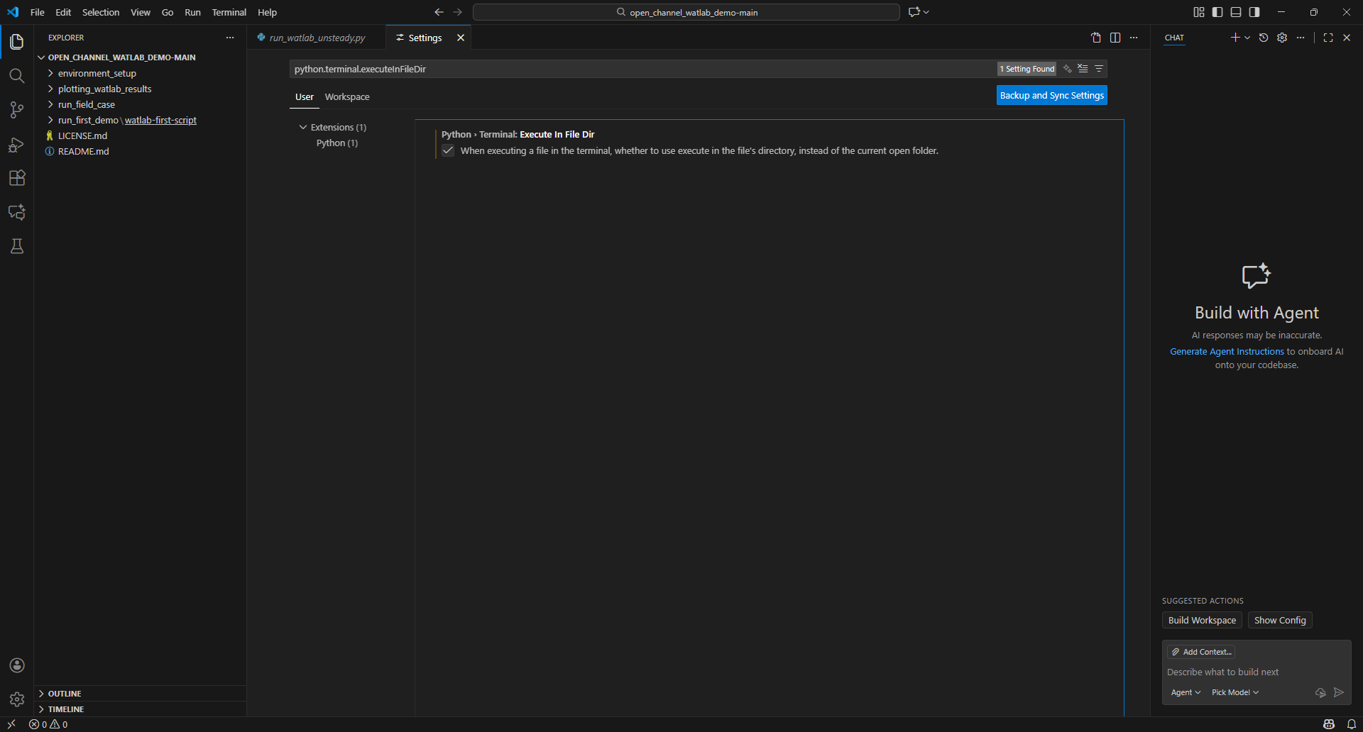
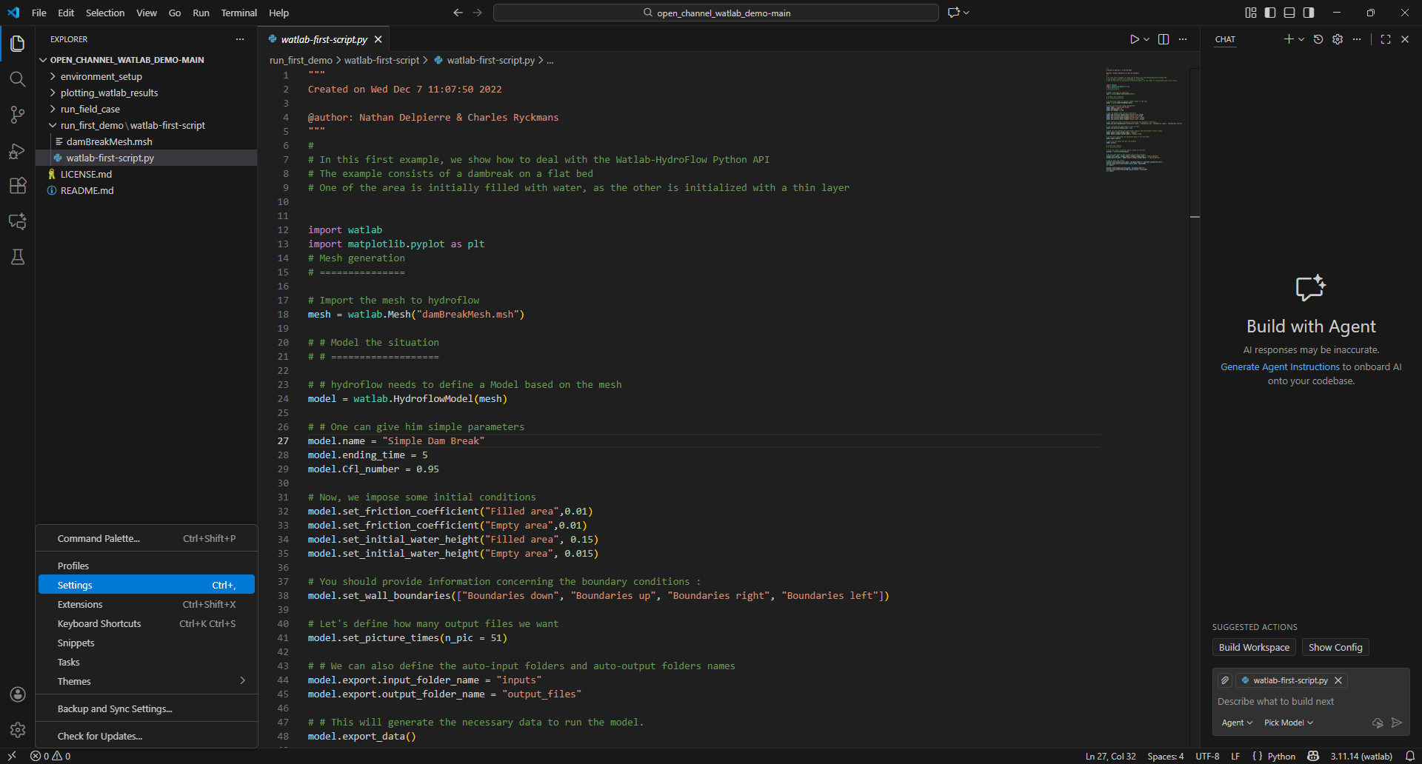
3. Search: “python.terminal.executeInFileDir”
4. Check this box
2.
Execute in the File direction
1.

Slide 32
Contents
Install Anaconda
Install Visual Studio Code
Watlab environment setup
Run the first watlab code

Slide 33
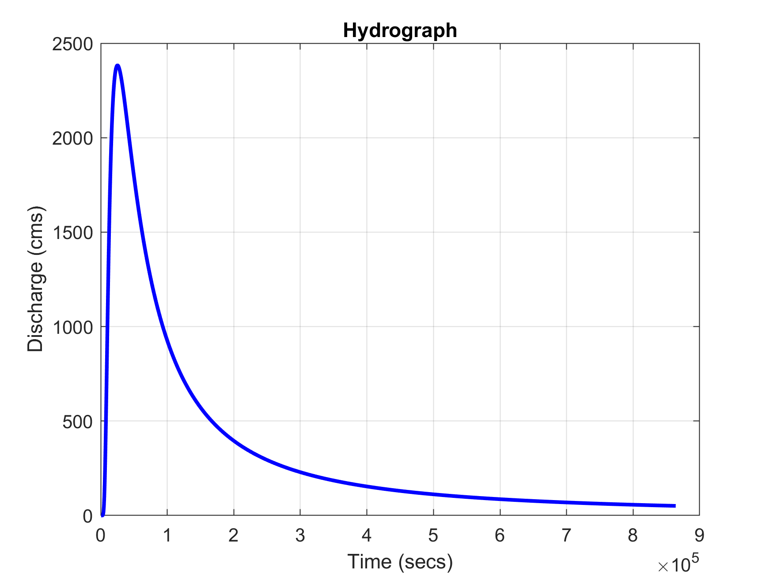
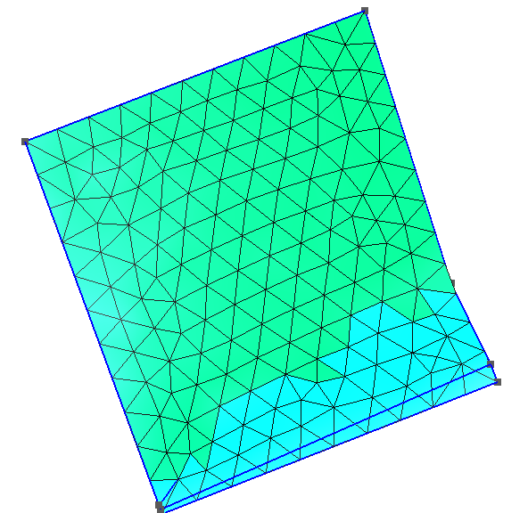
What is inside Watlab?
1. Pre-processing (Handle by Python):
watlab : reading the mesh (.msh file).
hydroflow : assigning properties like friction coefficients and boundary conditions, and translating them to the text file that C++ can understand.
2. Solving (Handle by C++)
It reads the simple text files generated by Python, runs the Finite Volume Method algorithms, and exports results to text files.
3. Post-processing (Handle by Python)
Pre-processing (Python)
Solving (C++)
Manning n
input
output
Watlab
(user interface)
hydroflow
(translator)
hydroflow-win.exe
(HLL solver)
.txt
.txt
hydrograph
mesh

Slide 34
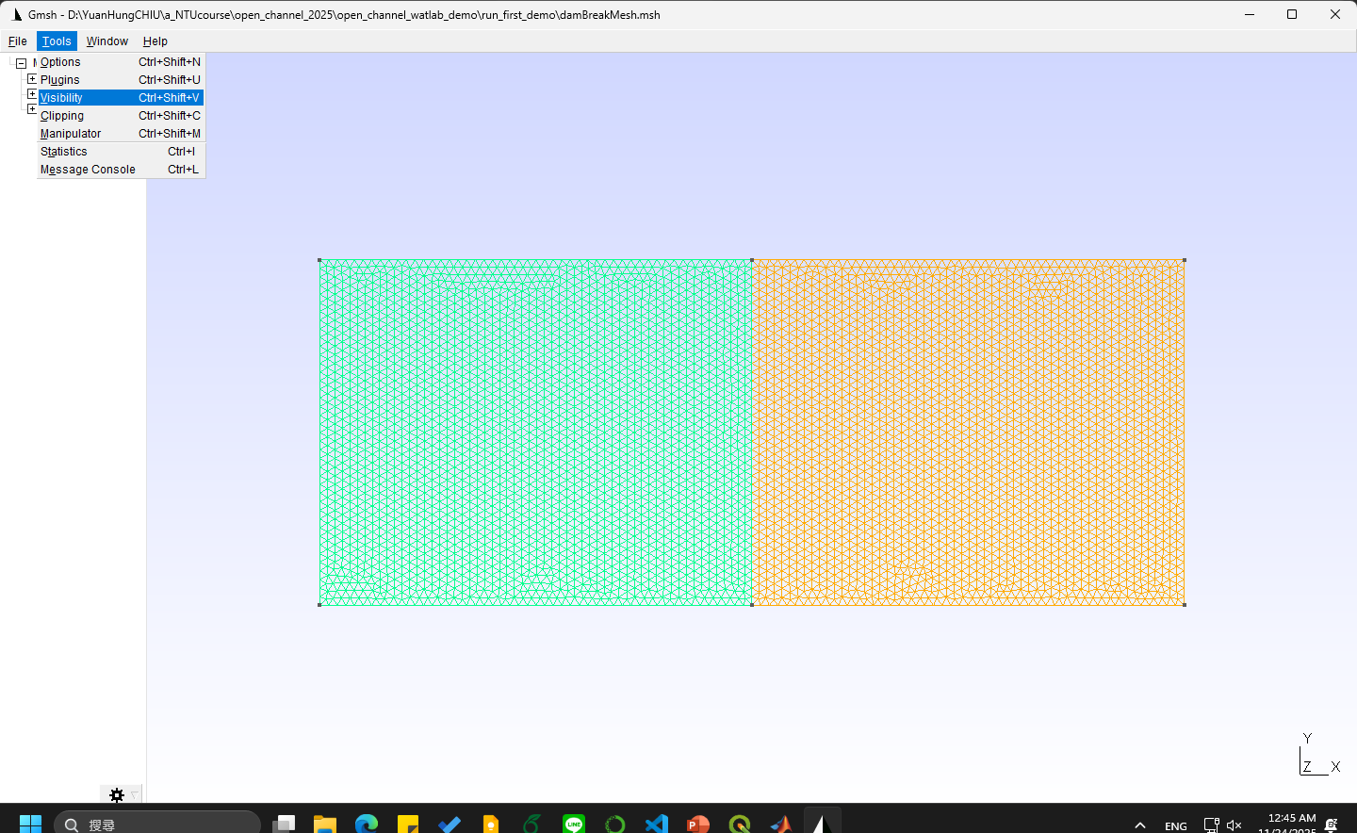
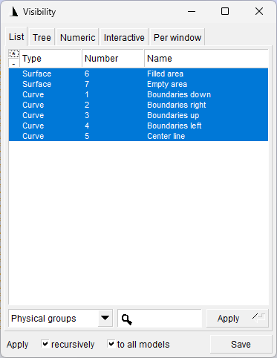

Download gmsh to open and check .msh files: https://gmsh.info/

Slide 35
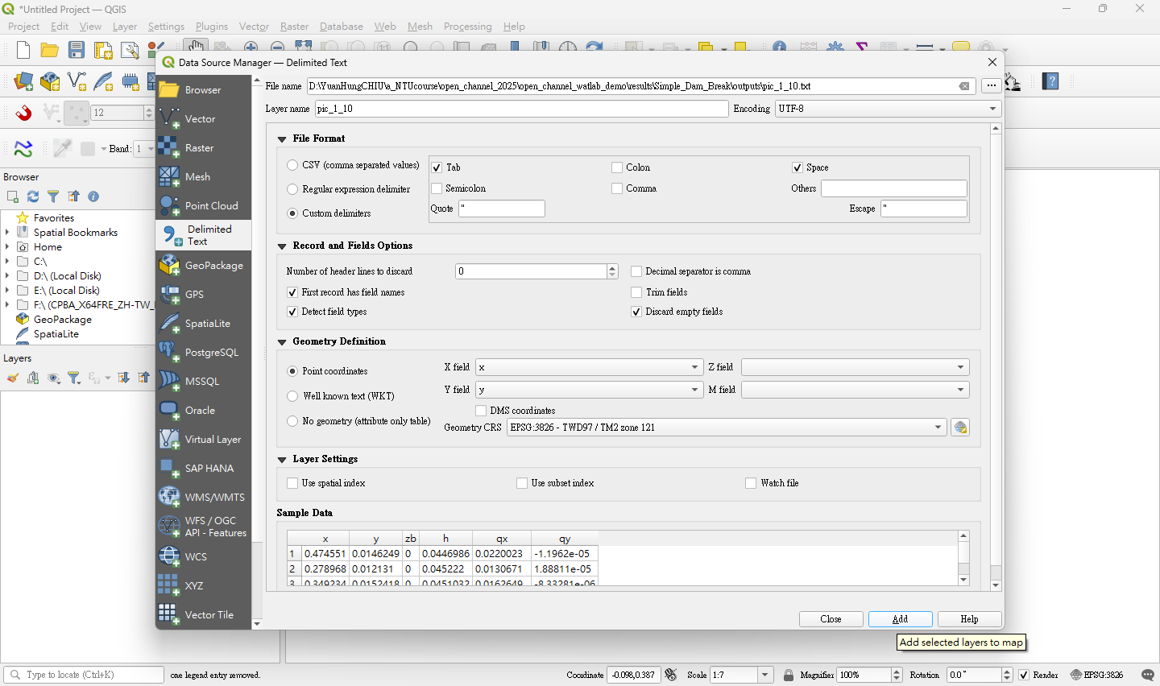
1. Give a pic_xx_xx.txt file.
2. Verify that the boxes match the ones shown here.
Post-processing in QGIS (1/3)

Slide 36
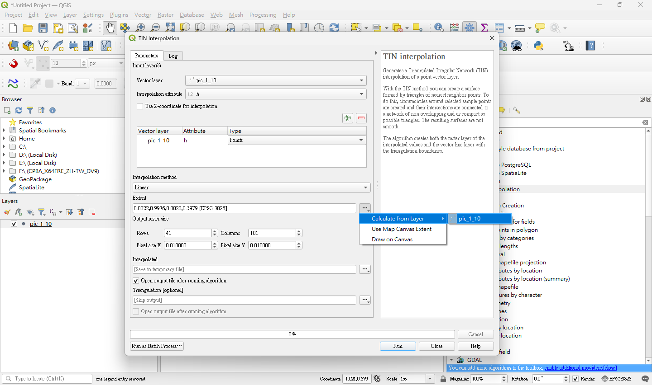
2. Select the points layer
3. Choose a variable
1. Search “TIN interpolation” in the toolbox.
4. Click here
5. Use points extent as raster extent
6. Give the raster resolution
7. Run !
Post-processing in QGIS (2/3)

Slide 37
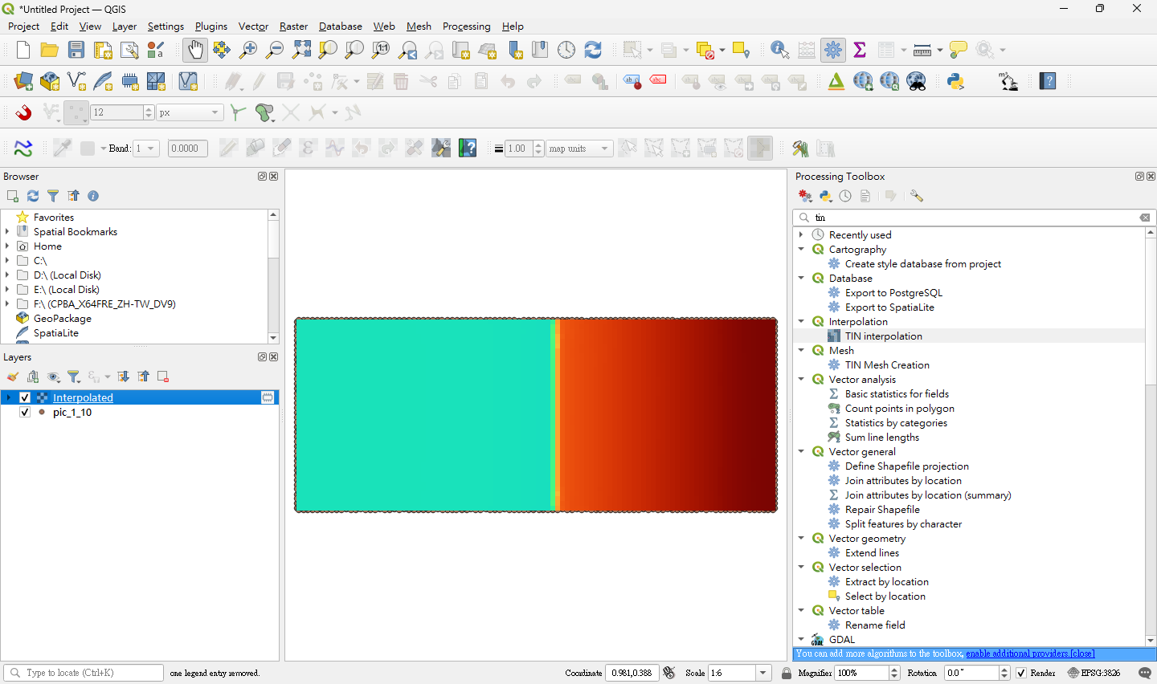
Post-processing in QGIS (3/3)

Slide 38

For more information, please find in the Watlab official website: https://sites.uclouvain.be/hydraulics-group/watlab/index.html

